Slide 1
Student Information Sharing Initiative
Presentation to RTLB
13 September 2018

Slide 2
Overview
What is the Student Information Sharing Initiative (SISI)?
What we have done so far?
Privacy and Access Model
Data Analysis ESR
SMS ESR
Information Sharing guidance
Exercise
Keeping the RTLB community involved
Notes:
Will RTLBs access SISI directly?
This is not currently planned. RTLBs will access their own systems as per usual.
What will change for RTLBs?
Some information about individual learners that is provided to the Ministry will be added to the learner record in the repository, and available to certain staff at the school.
What if RTLBs want different information provided to schools that isn’t currently provided to the Ministry?
We can most likely manage that, and would discuss with the RTLB sector how the additional data and information would be collected from the RTLB staff and provided into the repository
Could the RTLB database(s) be connected directly to the repository if RTLB staff wanted to be able to reuse data (e.g. biographic, class details) in setting up the learner for an RTLB programme?
Yes this is possible, the school would need to consent to you accessing the learner data in this way, and the RTLB databases would need to comply with the SISI security and privacy requirements, as well as the testing of the connection.
Some RTLB clusters are using the software to allow schools to jointly request Ministry and RTLB services. Will SISI replace this?
This is not being considered currently. There may be capability to manage service requests in the future, if desired.
Anything else you were thinking of?

Slide 3
What is SISI?

Slide 4
SISI Objectives
A learner’s information is available to support them throughout their entire education pathway – early learning services, schools/kura, and tertiary;
The data held about learners is accurate, consistent and timely.
Notes:
SISI is a key project within the Integrated Education Data (iEd) programme. SISI will allow information to automatically move with children and young people as they move through the education system.

Slide 5
How will we achieve this?
The SISI project will deliver a national repository of learner information
The repository will integrate with each kura and school’s student management system
Learner data will be recorded in the national repository, and therefore be available to the next kura or school when a child moves
Changes will be undertaken in all SMS systems to ensure improvements in data quality and consistency and deliver a standard learner administration process across all schools.
Notes:
Proposed scope – early learning services to compulsory sector and limited tertiary;
Strong focus on privacy and security;
Current identity and access practices at schools will need to map to Education Sector Login (ESL) service;
Deliverables/timeline
2018/19 Data Analysis Early Stage Rollout, SMS Early Stage Rollout

Slide 6
Sector’s benefits from SISI
Reduced administration overhead – more time to focus on supporting student achievement and wellbeing;
A better understanding of a student joining the school – ability to build rapport and support the student in the ways they need;
More consistent data – a common language;
Better quality data; and
Ability to use data to drive decision-making and support student cohort.
“Can only see positive things. We don’t have a lot of man power to be making phone calls and following everything.”
Notes:
Privacy, security and access of data being stored and shared;
Lifetime of the data – retaining relevance;
Abuse and misuse of data;
Change of behaviour – teachers or school staff sugar-coating information due to potential access by students and caregivers; and
Too much data shared, not giving the student a ‘fresh start’ – students being ‘put in a box’.

Slide 7
Developing detailed requirements with users

Slide 8
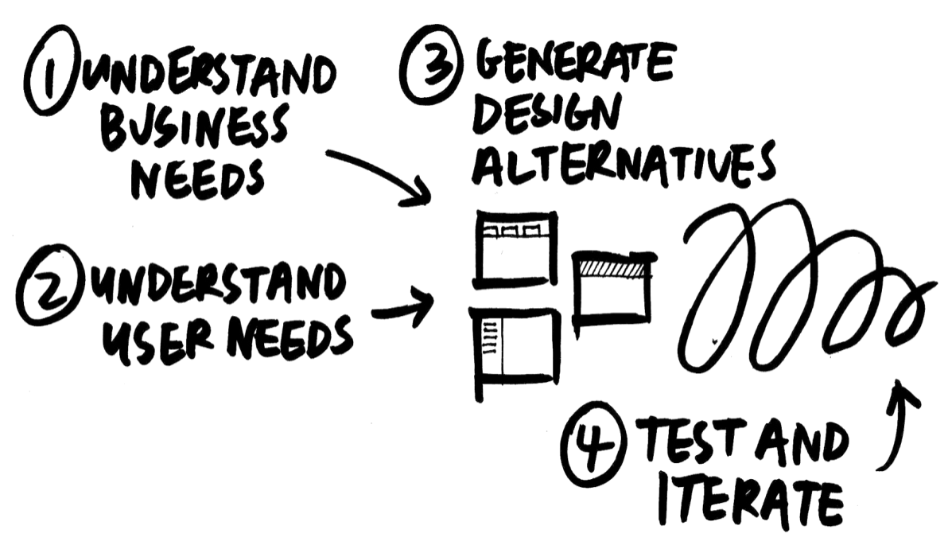
User-centred design approach used to develop detailed requirements
Notes:
Design is based on an explicit understanding of users, their needs, tasks and environments
Decisions are driven and refined by user-centered research and validation
The solution is designed to fit the user needs – addresses the whole user experience

Slide 9
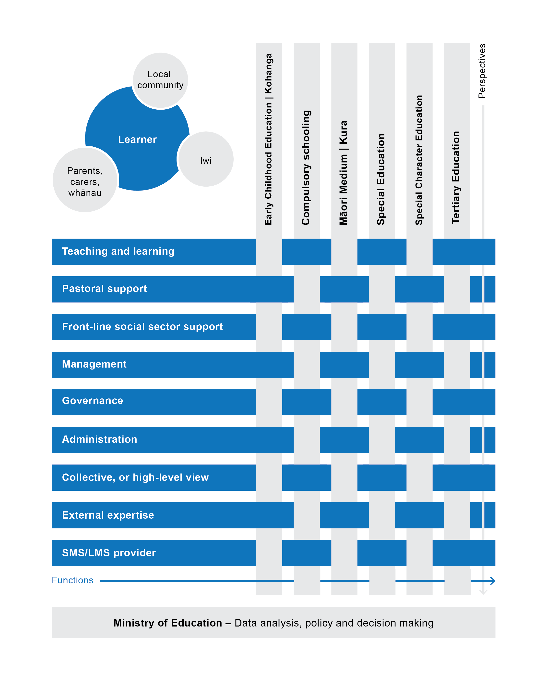
Understanding user needs
Notes:
We identified there were a number of activities in schools that required staff to use student information and recognised that individual school staff may be responsible for more than one of these functions. We designed workshops to ensure these staff undertaking all these functions were involved. We also wanted to ensure we had good coverage, both geographically and with different types of schools and schools staff.

Slide 10
School engagement for detailed requirements
Journey mapping workshops held in Term 3:
Collective view – Auckland
Administration – Dunedin
Teaching and Learning – Auckland
Management and Governance – Christchurch
Pastoral and Frontline Social Sector – Whakatane
Parents and Learners – Gisborne/Wellington
Maori Medium – Hamilton
21 interviews:
Special character school (Islamic), no SMS, cross Kāhui Ako teacher, Attendance Service, Board of Trustees representative, concurrent enrolment, health school, home schooling, privacy officer, Oranga Tamariki social worker.
Co-design workshops in Auckland and Whakatane.
Testing in Auckland, Thames and with principals/deputy principals from the SISI English Medium working group.
Over 2200 responses to a survey to collect feedback and information from schools/kura on a number of aspects of SISI.
Notes:
Co-design with schools
The Ministry has taken the key learnings from previous engagement with the sector and worked with schools in a series of workshops and interviews supported by a survey to identify pain points and to propose areas where there are opportunities for improvement.
Workshops were focused on creating current state journey maps that documented the processes related to the use of student information. The data needs, systems, interactions and/or channels used and pain points related to the process were captured.
The Ministry also worked with schools to co-design the new processes and the new ways of entering, using and/or sharing student information in numerous variations.

Slide 11
The information that should travel with a learner
Don’t share electronically (but a direct conversation may be needed)
Mental health
Sexual health
Counselling
Existence of abuse
Hospitalisation
Health and Wellbeing
Engagement
Biodata;
Achievement and progression
Sensitive data
Consistently share with appropriate permissions:
Health information
Behavioural support
External agency involvement (e.g. youth aid)
Oranga Tamariki information
Automatically and consistently share:
Name
Gender
Ethnicity
Iwi/hapu
Residency
Country of birth
Address
Languages spoken
Language proficiency
Caregivers details
Progression and achievement data
NCEA results
Learning support history/notes
Special education needs support
[may need appropriate permissions]
Attendance
Stand-downs
Suspensions
expulsions
Notes:
Participants were also asked to identify opportunities for improvement, particularly with a national learner repository in place, and to describe which data should be shared and in what way.

Slide 12
Journey map
[See wall charts]
Allows us to compare/contrast the current and future states
Provides a tool to socialise the findings, processes and SISI solution

Slide 13
Our Privacy & Access Model

Slide 14
Draft model
We put together a draft privacy and access model so that we could check our assumptions and plans with our Legal and Privacy teams, and provide guidelines to vendors in advance of building the SISI repository.
It covers the flow of data in and out of SISI, access to that data, and the authorisation for access to that data.
It assumes that the learner is the ‘owner’ of the data in the SISI repository, and that schools can access the data while that learner is enrolled.
It does not assume Education agency access to the data, other than for the existing information sharing provided for under the Act (and associated regulations).

Slide 15
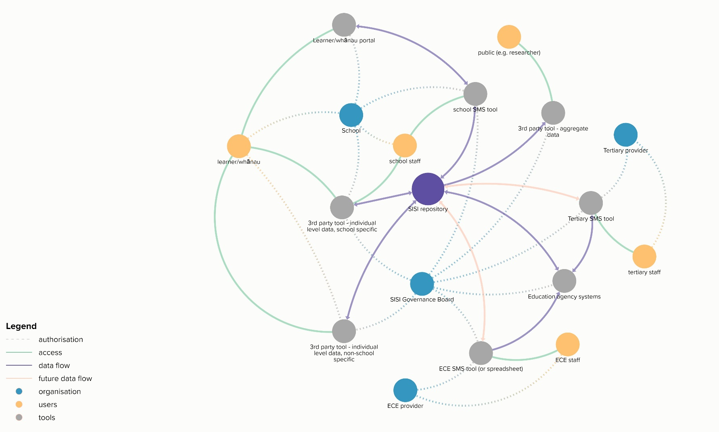
Privacy and Access Model

Slide 16
Schools
Access SISI via their SMS, granted by Principal or Delegated Authoriser.
There may be info in SISI that is not available for download but can be seen by certain staff.
Can update records in SISI for a currently or recently enrolled student.
Concurrent providers (e.g. technology centres) can read and update selected parts of a student’s record.
Schools can’t update school-specific data entered by another school or provider.

Slide 17
Education agencies
Information that is agreed to be shared with the Education Agencies will be passed from SISI to the relevant agency by either schedule or subscription.
Cannot be extended without agreement by the SISI Governance Board.
Information shared by agreement at aggregate level will not automatically be shared at learner level without agreement by the SISI Governance board.

Slide 18
Learners and whānau (via schools)
Schools must provide a privacy statement to learners/whānau about the data that is stored/accessed from SISI.
Schools will grant access to learners and/or whānau to their existing learner/parent portals (if available).
Schools determine what learners and whānau can see.
Schools verify identity of those they give access.
Learners can choose to restrict or deny access to a parent (e.g. an estranged or non-custodial parent); restriction on access can also originate in Family Court orders/protection orders.
Access via a school-provided portal ends when the learner leaves that school.

Slide 19
Data Governance
A data governance board will be established to provide oversight of the activities that will include:
Establishing, agreeing and approving the business rules related to access to learner data in the SISI learner repository as they apply to all stakeholders, including researchers and education agencies;
Governing changes to those rules.
The proposed Privacy and Access model will help define the business rules.

Slide 20
Openness and Transparency
The Ministry is starting a new workstream on openness and transparency.
This workstream will look at building trust in how we use data. The goal is that the Ministry and sector:
Agree principles for information use
Agree mechanisms for transparency (inc shared governance where appropriate)
Agree an approach for applying the Social Investment Agency Data Privacy and Use Policy.

Slide 21
Information Sharing Guidance
You heard yesterday from Esther Harcourt about the guidance for learning support on information sharing and when you need to get consent from parents.
The SISI team are involved in the work underway to provide similar guidance for other groups sharing information about learners.
We have also engaged a privacy expert to work with us for the current phase of our work.
Notes:
Note that in the future, SISI could be where the Learning Support register is created and managed.

Slide 22
Early Stage Roll-out (ESR) plan

Slide 23
Data Analysis ESR Overview
This ESR will demonstrate the BI and Analytics capability that the full SISI platform will provide.
Student data will be extracted from the multiple SMS tools used by the schools in a selected Kāhui Ako using the SMS’ existing data extract capabilities.
Data will be manually extracted and uploaded into a Kāhui Ako repository.
The data will likely need to be cleaned and prepared, so a robust and repeatable process will need to be implemented to do this.
Appropriately authorised school staff from the Kāhui Ako will have access to the aggregated data in the repository via the SISI platform’s BI interface.

Slide 24
Purpose of this ESR
To provide a group of schools with unified access to their SMS data to support their analysis and exploration of that data using BI and analytics tools;
To give early visible signs of progress to stakeholders;
To reduce the risks involved in the full SISI rollout by:
proving the platform with a small part of the solution, namely the integration with Ministry systems and authentication mechanisms; and
getting as much insight as possible into the data areas of wellbeing, and achievement, assessment and progress.

Slide 25
SMS ESR Overview
The SMS ESR will involve a technology centre and their client schools. This ESR will demonstrate the movement of data between SMSs using the national learner repository.
Appropriately authorised school staff from both the Technology centre and the client schools will have access to the data in the repository via their SMS.
Notes:
This ESR will demonstrate the data exchange capability that SISI will provide;
Specialist technology subjects such as Materials Technology (e.g. textiles, wood, metal) and Food Technology require specialist teaching facilities, which aren’t available at all schools. Where these facilities are not available at their base school, Years 7 & 8 students attend technology classes at a nearby school;
Student data will be electronically exchanged between a Technology centre and its client schools;

Slide 26
Purpose of this ESR
To provide a technology centre with access to data about the students coming onsite for technology classes, and the client schools with access to the information collected about their learners while they are at the technology centre;
To reduce the risks involved in the full SISI rollout by proving the platform with a small but critical part of the solution, in this case the transfer of data between two schools using different SMS tools, via the SISI repository;
To test the roll out of functionality (people, process and technology).
Notes:
*As per lessons learned in other high-profile government rollouts (e.g. Novopay), this is best practice and non-negotiable.
Specialist technology subjects such as Materials Technology (e.g. textiles, wood, metal) and Food Technology require specialist teaching facilities, which aren’t available at all schools.
Where these facilities are not available at their base school, Years 7 & 8 students are also concurrently enrolled at a Technology Centre at a neighbouring school.
This means that student data needs to be transferred to the Technology Centre from the base school to enable students to attend these specialist subject classes.
This high-level use case provides an ideal opportunity to prove the transfer of data between the base school SMS and their Technology Centre (and back again).

Slide 27
RTLB Requirements

Slide 28
Exercise
With SISI in place there will be opportunities to improve the flow of information about learning support.
In the context of RTLB, what are the three most important things you would like to know from the Ministry?
What are the three most important things (in the context of RTLB services) you would want included in a learner’s record?

Slide 29
Keeping the RTLB community involved

Slide 30
How we’re keeping the sector involved
SISI working groups support, endorse and own the development of the SISI detailed business requirements and supporting business processes. Two groups have been established:
SISI English-medium Working Group, Chair, Graeme Barber
SISI Māori-medium Working Group, Chair, Rubina Wheeler
Loomio online discussion group
Online Kura and Schools Focus group
Interviews at schools
Notes:
Focus group
A representative group of SMS users from schools and kura has been approached to help support the SISI project team with refinement of the detailed requirements for the SISI repository. This group is asked to provide feedback and to give input to items varying from data that they think needs to be exchanged via the repository to specific ways that they would like to interact with their SMS. Membership is limited to those who have had previous engagement with SISI through the co-design, workshop, testing and interview phases of the project.

Slide 31
How would the RTLB community like to stay connected with SISI?

Slide 32
Additional information
Material on Ministry website including the report developed by the DELTA programme which preceded the current iteration of SISI
https://education.govt.nz/ministry-of-education/specific-initiatives/integrated-education-data-ied-programme/student-information-sharing-initiative-sisi/

